Slide 1
Sharing our musical heritage
Members of the project
2016-2017

Slide 2
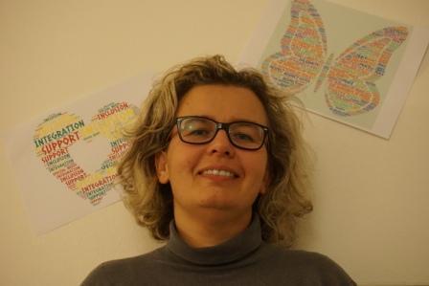
ICS di Porto Garibaldi, Porto Garibaldi (FE) Italy
Hello
Dear friends, Mi name is Barbara. I'm a support teacher and I work in the same Primary school with Angela, Lucia and Giulia in Porto Garibaldi, Italy. I'm happy to help children with special needs.
I love music and dance. Nice to meet you. Barbara

Slide 3
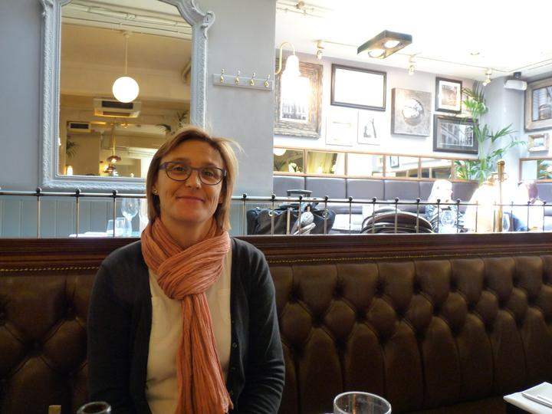
Ecole élémentaire Vercingétorix, Aubiere France
Bonjour
My name is Caroline. I am a french teacher in a primary school in the center of France. I work in Aubiere near Clermont Ferrand where I live. I like travelling, reading, dancing. Nice to meet you dear european friends

Slide 4
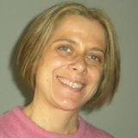
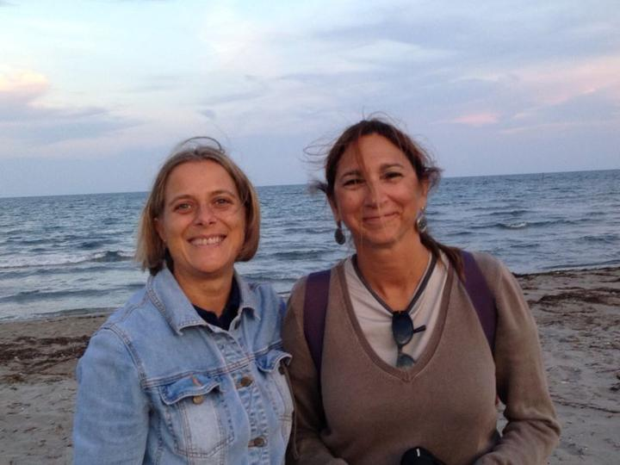
Ciao
Ciao! I'm Caterina from Mestre, Italy. I teach in a primary school. I teach Italian, English, History and art. I love reading, listening to music and walking in the mountain. I like to be in this project with you!
ICS "F. Querini" di Venezia, Venezia (VE) Italy
Ciao!
I'm Giovanna. I work in a primary school in Mestre with Caterina. I teach Math, Geography, Gim, Science and Music. I help Caterina with songs and dances. I love cooking, reading, going to the beach and France. In this photo are Caterina and me on the beach.

Slide 5
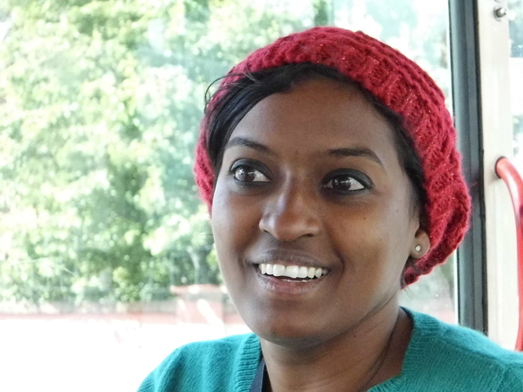
Collège Achille Grondin, Saint Joseph France
Hi there, I am Edwige. I teach English to children aged 12 -15 years-old in Reunion Island. It is a small island in the middle of the Indian Ocean. We speak French and Creole. And so we learn English.

Slide 6
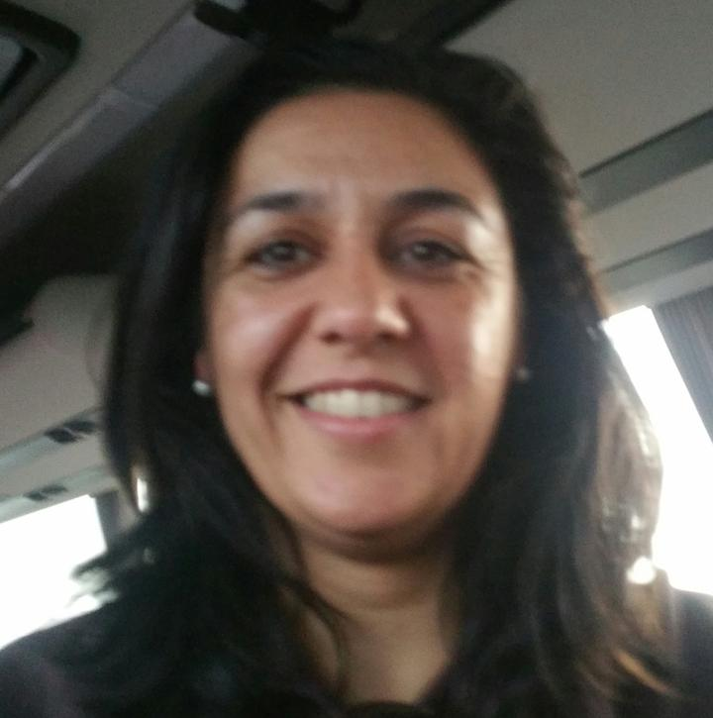
C. E. I. P. Virgen de Barbaño, Montijo Spain
Hola
Hello, my name is Esperanza. I am a Primary school teacher from Spain. I like singing. I usually sing as soprano in the Parent's choir in the Conservatory in Montijo.
I help in this project doing art and craft with my pupils and singing your songs with them.
I like listening to music and dancing. Nice to meet you. Esperanza

Slide 7
C. E. I. P. Virgen de Barbaño, Montijo Spain
Holaaaa, qué tal?
My name is Esther, I play the guitar and I love the music.I am Music teacher at CEIP "Virgen de Barbaño" Spain. Nice to meet you :) Esther

Slide 8
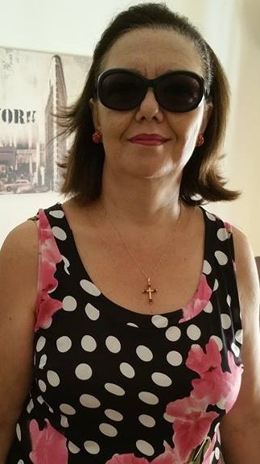
ICS Porto Garibaldi" di Comacchio, Comacchio (FE) Italy
Hi, my name's Giulia and I'm a teacher at the Primary school in Porto Garibaldi (Ferrara -Italy).
I think it's very important to update frequently and I believe Technologies give me the oportunity to aquire new knowledge. I'm happy to take part to e-Twinning projects because they allow me to know new realities and let me cooperate with european partners.

Slide 9
Mehmet Akif Ersoy İlkokulu
Merhaba
I am Jbdun Uysal from Turkey Aydın. I am the English teacher of Mehmet Akif Ersoy Primary School. I have been a teacher there for 4 years. I was graduated from American Culture and Literature. I like travelling and meeting new people. Me and my students are very happy to be a part of this enjoyable project. It was very nice to be with you and know you all. Take care :)

Slide 10
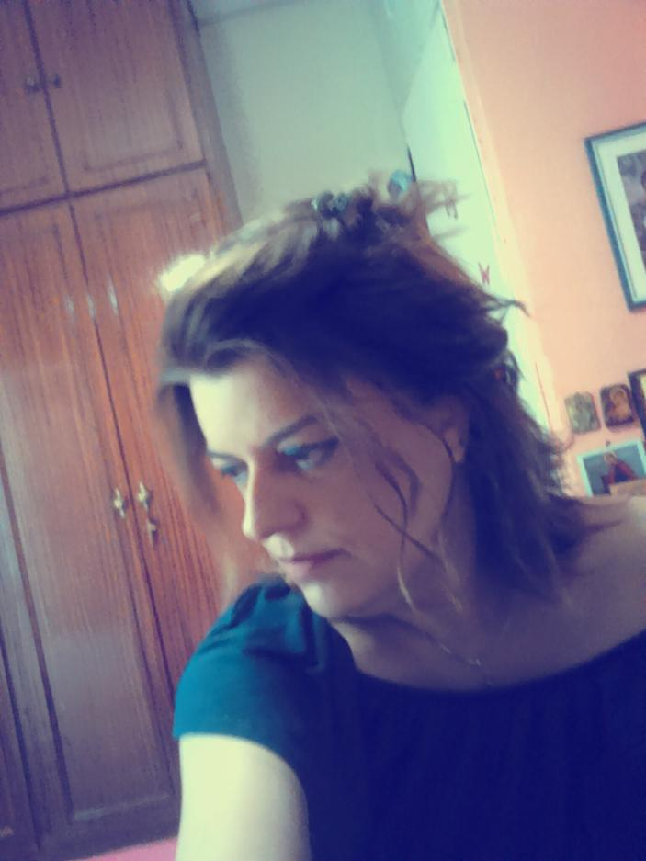
1st Primary School of Ampelonas , Larisa ,GREECE, Ampelonas Greece
Γεια σας !
My name is Katerina Velesiotou and I have been working as a teacher of music for 18 years (primary school education). I am also graduated in the School of Primary Education of Aristotle University of Thessaloniki .
As the time passes I realize that cooperation is a great source of professional and personal development. My endless effort is to knock down the wall of selfishness as a teacher and as human being.

Slide 11
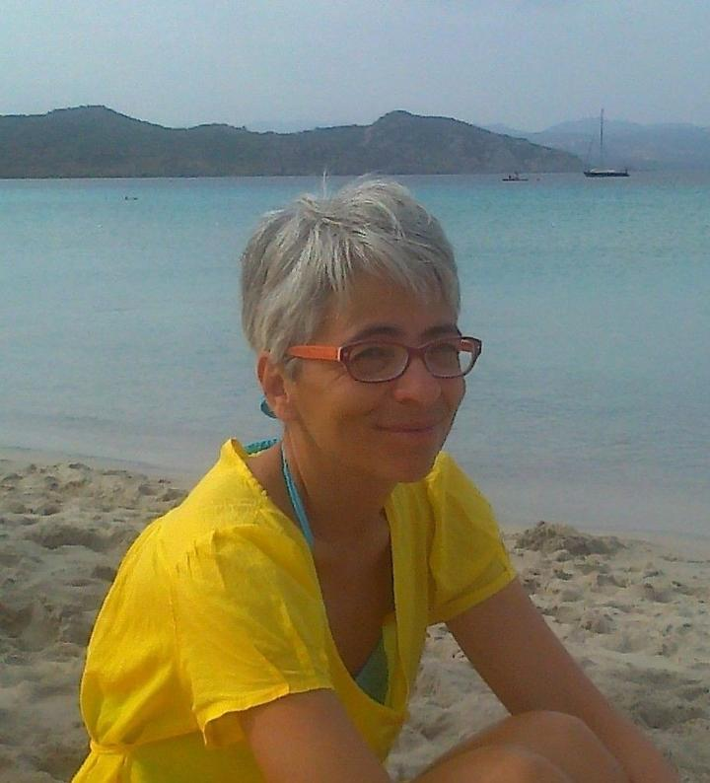
ICS di Porto Garibaldi, Porto Garibaldi (FE) Italy
Hello! My name is Lucia and I live in Porto Garibaldi.I've been teaching for 34 years at primary school. I love music, the Impressionist painters and my work. Thank to my collegue Angela I learned to appreciate the eTwinning projects. I'am happy to take part to this project.

Slide 12
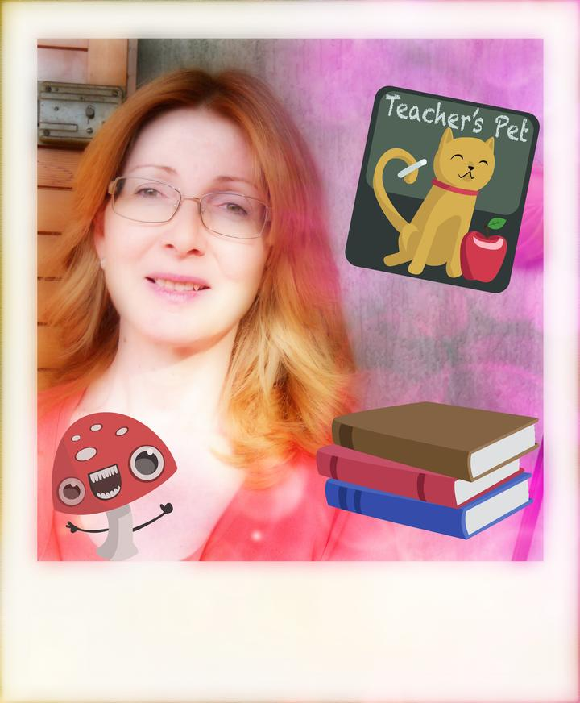
ICS di Porto Garibaldi, Porto Garibaldi (FE) Italy
Hello
My name is Angela, I live in Porto Garibaldi, a little town near Adriatic sea. I've been teaching for 33 years, I love eTwinning projects and
I love Music! I'm so happy to meet you and I'm looking forward to listen my pupils singing with European new friends.

Slide 13
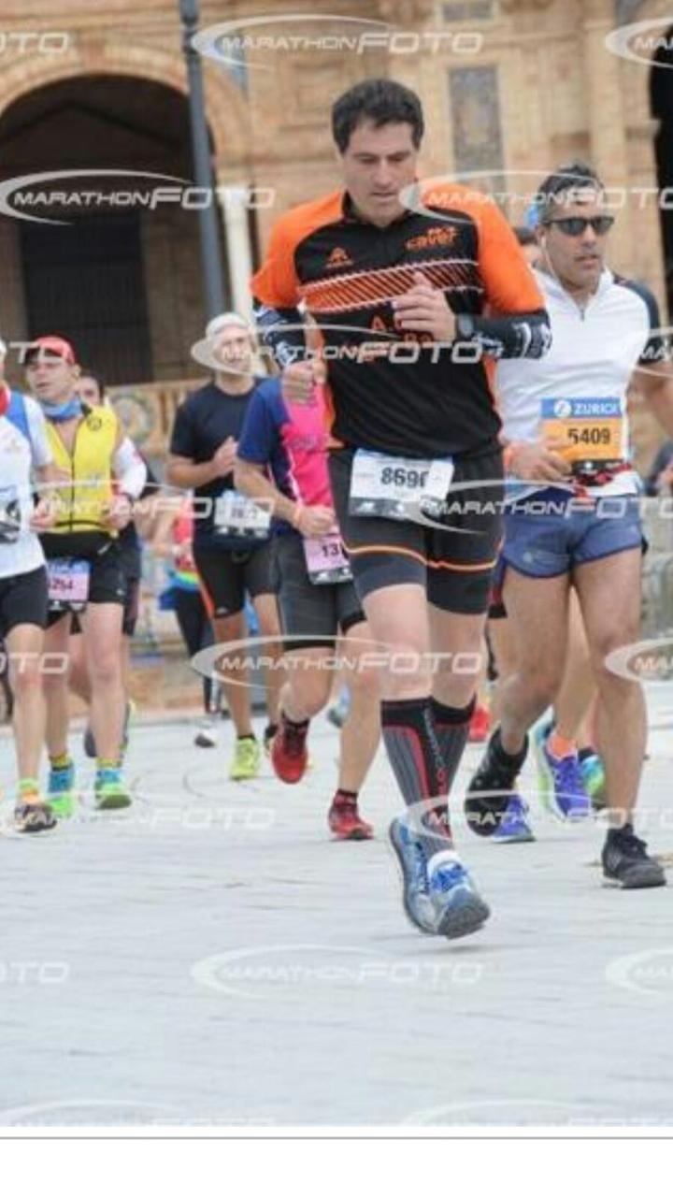
C. E. I. P. Virgen de Barbaño, Montijo Spain
Hola
Hi, my name is Luis. I am a PE teacher from Spain. I help in this project with the dances. I enjoy running and teaching. Nice to meet you. Luis

Slide 14
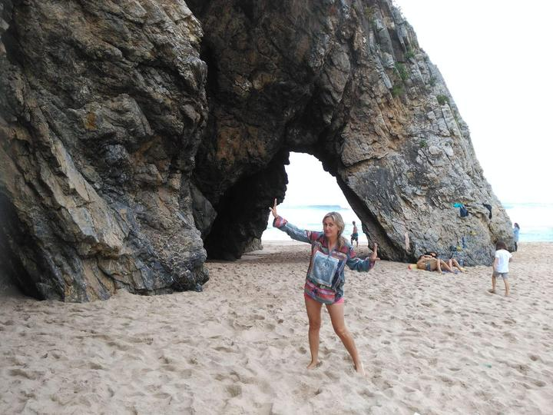
CEIP "Virgen de Barbaño", Montijo Spain
Hola
My name is Trini. I was born in Cádiz (a town in the south of Spain) but I work and live in Badajoz (the southwest of Spain). I am one of the English teacher in my school. I love travelling, listening to music, dancing and teaching English. My favourite place is the beach. Nice to meet you. Trini

Slide 15
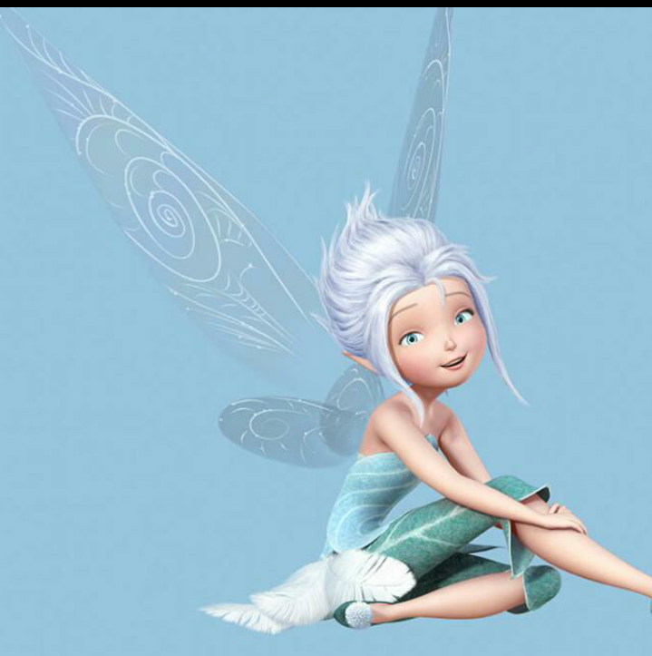
Hola
My name is Juani. I am from Spain. I am a Primary school teacher. I help in this project with the French and Italian pronunciation. I like extreme sports (rock climbing, paraglinding,..) I love natural parks and the countryside. This is my avatar. Nice to meet you.

